Slide 1

FRIVail: A Data Availability Scheme
Scaling to 10GB Blocks
Rachit Anand Srivastava
Sr. R&D, Avail
Notes:
Hi everyone, I'm Rachit, Sr. R&D at Avail. Today I'll talk about FRIVail, a data availability scheme built on FRI and the Binius stack, and how we're designing it to scale to 10 GB blocks.
Plan: first the problem and the existing designs, then FRIVail itself, the soundness catch and how we close it, benchmarks, and where we are on rollout.

Slide 2
The Problem
Section 1
Notes:
Let's start with where data availability sampling stands today and why it doesn't get us to 10 GB blocks.

Slide 3
Current State of DAS and Cryptography
KZG
HASH
COST
PeerDAS on Ethereum
Merkle + fraud proofs
Costs remain
Ethereum adopted PeerDAS, a KZG-based DAS scheme.
Other constructions use Merkle commitments, secured by fraud proofs.
Every scheme carries overhead. Deployed PCS-based designs are not post-quantum. ZK and PCS are still expensive.
Recent breakthroughs: ZODA · FRIDA · Binius (ZK)
Notes:
Three things define the landscape.
First, Ethereum adopted PeerDAS, which is KZG-based.
Second, other constructions use Merkle commitments and get their security from fraud proofs.
Third, the costs: every scheme carries some overhead, the deployed PCS-based designs are not post-quantum, and ZK and PCS are still expensive.
There's been real progress, though: ZODA, FRIDA and Binius on the ZK side. Those are the building blocks we draw on.

Slide 4
A Deep Dive into Existing Designs
 | KZG-based | Fraud-proof-based
Commitment | Polynomial commitments over bilinear pairings | Merkle trees (hash-based)
Correctness | Validity proofs, constant size | Fraud proofs, constant size
Post-quantum | No: relies on pairings | Yes: hash-based
Practicality | Expensive and hard to prove in ZK. Prime fields, not binary, so not CPU-native | True finality waits for the challenge period
Overhead | Extra row/column commitments must be downloaded for reconstruction | An honest node must rebuild the full 2k × 2k square (~4k² shares) to detect and prove mis-encoding
Notes:
Comparing the two families side by side.
KZG gives validity proofs with constant size, but it relies on bilinear pairings, so it's not post-quantum. It's expensive, hard to prove inside ZK, and works over prime fields rather than binary, so it isn't CPU-native. Its overhead is the extra row and column commitments you download for reconstruction.
Fraud-proof designs are hash-based, so they are post-quantum, and proofs are also constant size. But true finality waits for the challenge period, and an honest node has to rebuild the whole 2k by 2k square, about 4k squared shares, before it can detect and prove mis-encoding.
Neither scales cleanly to 10 GB.

Slide 5
Noteworthy Mentions
ZODA
FRIDA
+ Zero overhead: encoded rows are themselves the proof of correctness
+ Erasure coding with a linear code
– Relies on fraud proofs
– ZK-verifiable variants (the “Accidental Computer” paper) are very expensive
+ Built on FRI
– Expensive to scale, especially at 10 GB+
FRIVail reuses FRIDA’s sampling fix
Notes:
Two newer designs worth calling out.
ZODA is zero-overhead: the encoded rows are themselves the proof of correctness, using a linear code for erasure coding. But it's fraud-proof based, and the ZK-verifiable variants, from the Accidental Computer paper, are very expensive.
FRIDA builds on FRI, but it's expensive to scale, especially at 10 GB and above. We do borrow one key idea from FRIDA, its sampling fix, which I'll come back to.

Slide 6
Achieving 10 GB/Block
✓
Zero overhead
✓
Post-quantum: hash-based
✓
Sharded design
✓
Economic security covers the gap until state-of-the-art proving costs come down
✓
Core DA properties kept: erasure coding, reconstruction, opening
Notes:
So what does a design need to hit 10 GB per block?
Zero overhead. Post-quantum, meaning hash-based. A sharded design.
Where full proving is still too expensive, economic security covers the gap until state-of-the-art proving costs come down.
And it must keep the fundamental DA properties: erasure coding, reconstruction and opening.

Slide 7
FRIVail
Section 2
Notes:
With those requirements in mind, here's FRIVail.

Slide 8
Balancing encoding, security and scale for 10 GB blocks
1
Binary fields: extremely fast computation
2
FRI does the erasure coding: a single FRI commitment is enough to show the encoding is correct (with one catch, covered shortly)
3
Sharded proving: each shard proves its own row. FRI proofs are verified at the economic layer (live on mainnet) or a recursive ZK layer (in progress, for validity proofs)
4
Row-level erasure coding only: the trade-off that makes 10 GB/block and beyond possible
5
Infinite horizontal scaling at the network layer
Notes:
Five design choices.
One, binary fields, which make computation extremely fast.
Two, FRI does the erasure coding internally, so a single FRI commitment is enough to show the encoding is correct, with one catch we'll get to in a moment.
Three, sharded proving: each shard proves its own row. Those FRI proofs are verified at the economic layer, which is live on mainnet, or at a recursive ZK layer for validity proofs, which is in progress.
Four, we only erasure-code at the row level. That's a deliberate trade-off to reach 10 GB per block and beyond.
Five, that gives us effectively unlimited horizontal scaling at the network layer.

Slide 9
How FRIVail Works
1
Encode
2
Commit
3
Prove
bytes → multilinear polynomial → Reed–Solomon codeword (2× blow-up)
Merkle roots of the codeword and every FRI fold layer
FRI folds the codeword to a terminal codeword; L random queries check each fold is consistent
4
Verify
5
Sample
6
Recover
the codeword is within the unique-decoding radius of one RS codeword
each light-client sample is checked as one extra FRI query at index i
(ρ_{r+1} = QSelect(i))
any 50% of the codeword rebuilds the data
Notes:
End to end, six steps.
Encode: bytes become a multilinear polynomial, then a Reed-Solomon codeword with 2x blow-up.
Commit: Merkle roots of the codeword and of every FRI fold layer.
Prove: FRI folds the codeword down to a terminal codeword, and L random queries check that each fold is consistent.
Verify: this establishes the codeword is within the unique-decoding radius of one RS codeword.
Sample: each light-client sample is checked as one extra FRI query at index i.
Recover: any 50% of the codeword rebuilds the data.
Step five is where the subtlety is, so let's look at it.

Slide 10
The catch: FRI proves the codeword is close. Each sample must also lie on the polynomial.
The gap
FRI only proves the codeword is close, so a few positions can still be wrong
A Merkle proof only shows that a value sits under the root
So a sampled value can be committed and still not lie on the polynomial
The fix (from FRIDA)
Open each sample as an extra FRI query, with
ρ_{r+1} = QSelect(i)
A wrong value fails some fold check on the way down to the terminal codeword
This holds for any query, even one the prover picks
Notes:
Here's the gap.
FRI only proves the codeword is close to a valid codeword, so a few positions can still be wrong. A Merkle proof only shows a value sits under the root. Put together, a sampled value could be committed and still not lie on the polynomial.
The fix, from FRIDA: open each sample as an extra FRI query, with rho r-plus-one equal to QSelect of i. A wrong value then fails some fold check on the way down to the terminal codeword. And that holds for any query, even one the prover chooses.

Slide 11
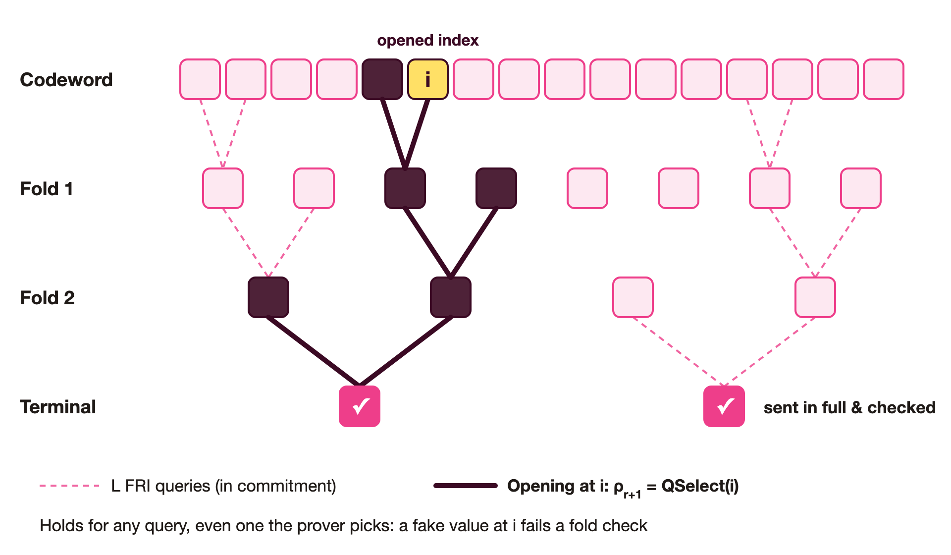
Sampling as an Extra FRI Query
Notes:
Visually: the dashed paths are the L FRI queries already in the commitment. The solid path is the opening at index i, which we walk down through every fold layer to the terminal codeword, which is sent in full and checked.
If the value at i is fake, one of those fold checks breaks. That's why sampling inherits FRI's soundness instead of just Merkle inclusion.

Slide 12
Performance Benchmarks
Row Size | Redundancy | Commit Time (ms) | Proof Time (ms) | Proof Size (KB)
4 MB | x2 | 9.46 | 9.16 | 183.44
8 MB | x2 | 15.30 | 14.47 | 214.16
16 MB | x2 | 29.46 | 24.20 | 239.53
32 MB | x2 | 56.48 | 40.92 | 274.25
1 GB | x2 | 1272
57 ms
41 ms
1.5×
to commit a 32 MB row
to prove a 32 MB row
proof growth for 8× more data (183 → 274 KB)
Notes:
Numbers, all at 2x redundancy.
Committing a 32 MB row takes about 57 milliseconds, and proving it about 41.
The part I like most is proof size: going from a 4 MB row to a 32 MB row is 8 times more data, but the proof only grows about 1.5x, from 183 to 274 KB.

Slide 13
Devnet
Testnet
Mainnet
Rollout Roadmap
LIVE
LIVE
IN PROGRESS
Devnet live since July 2024
Turing & Infinity testnets live since October 2024
Mainnet deployment and upgrade in progress
Notes:
Rollout status. Testnet is live.
Devnet has been live since July 2024. Mainnet deployment and upgrade are in progress.

Slide 14

Thank you!
Rachit Anand Srivastava
Sr. R&D, Avail | rachit@availproject.org
@privacy_prophet
Notes:
Thank you. Happy to take questions. You can reach me at rachit@availproject.org or @privacy_prophet.

